Slide 1
Lecture 19
Graphs (I)

Slide 2
Graphs: Definitions
A graph G consists of a set V, whose members are called the vertices of G, together with a set E of pairs of distinct vertices from V .
The pairs in E are called the edges of G.
If e = (v, w) is an edge with vertices v and w, then v and w are said to lie on e, and e is said to be incident with (邻接) v and w.
If the pairs are unordered, G is called an undirected graph.
If the pairs are ordered, G is called a directed graph. The term directed graph is often shortened to digraph, and the unqualified term graph usually means undirected graph.
Two vertices in an undirected graph are called adjacent (相邻的) if there is an edge from the first to the second.

Slide 3
Examples of Graphs
2
4
5
1
3
6
G₁
V(G₁)={1,2,3,4,5,6}
E(G₁)={<1,2>, <2,1>, <2,3>, <2,4>, <3,5>, <5,6>, <6,3>}
1
5
7
3
2
4
6
G₂
V(G₂)={1,2,3,4,5,6,7}
E(G₁)={(1,2), (1,3), (2,3), (2,4),(2,5), (5,6), (5,7)}

Slide 4
Graphs: Definitions
A path is a sequence of distinct vertices, each adjacent to the next.
A cycle is a path containing at least three vertices such that the last vertex on the path is adjacent to the first.
A graph is called connected (连通的) if there is a path from any vertex to any other vertex.
A free tree is defined as a connected undirected graph with no cycles.
In a directed graph a path or a cycle means always moving in the direction indicated by the arrows. Such a path (cycle) is called a directed path (cycle).

Slide 5
Graphs: Definitions
A directed graph is called strongly connected (强连通) if there is a directed path from any vertex to any other vertex. If we suppress the direction of the edges and the resulting undirected graph is connected, we call the directed graph weakly connected (弱连通).
The valence (or degree) of a vertex is the number of edges on which it lies, hence also the number of vertices adjacent to it.

Slide 6
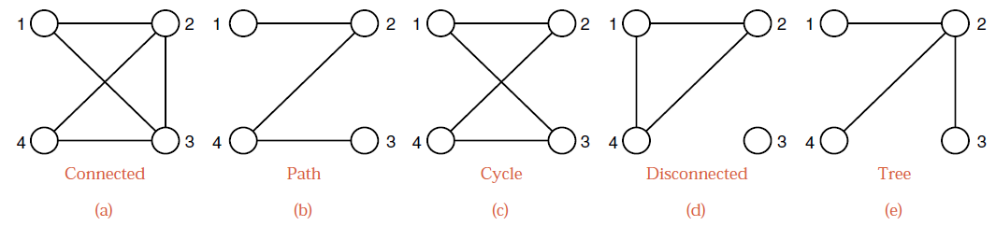
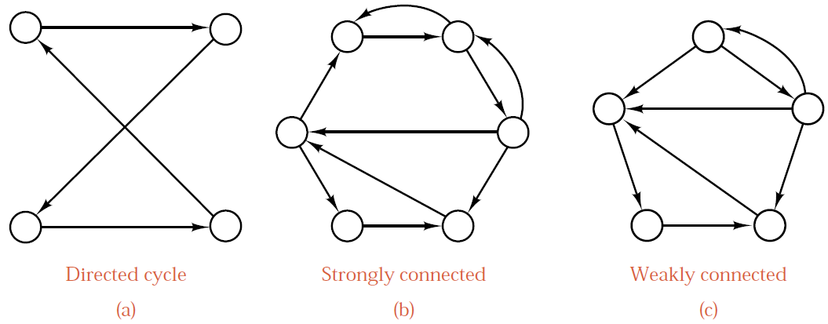
Examples of Graphs

Slide 7
Graphs: Definitions
A complete graph is a simple undirected graph in which every pair of distinct vertices is connected by a unique edge. Number of edges: n(n-1)/2.
A complete digraph is a directed graph in which every pair of distinct vertices is connected by a pair of unique edges (one in each direction). Number of edges: n(n-1).
A dense graph (稠密图) is a graph in which the number of edges is close to the maximal number of edges.
A sparse graph (稀疏图) is a graph with only a few edges.
Weighted graph (带权图) and Unweighted graph (无权图): In weighted graphs, each edge (or vertex) of G is assigned a numerical value, called weight or cost.

Slide 8
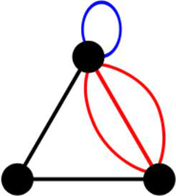
Graphs: Definitions
An edge (x, y) is a multi-edge if it occurs more than once in the graph.
Any graph which avoids these structures is called simple graph (简单图).
An acyclic graph does not contain any cycles. Trees are connected acyclic undirected graphs.
Directed acyclic graphs (有向无环图) are called DAGs.

Slide 9
Graph Representations
There are two main data structures used to represent graphs.
  Adjacency Matrix (邻接矩阵)
  Adjacency Lists (邻接表)
  Chained Forward Start* (链式前向星)
We assume the graph G = (V, E) contains n = | V | vertices and m = | E | edges.
Assume that the graph is a simple graph. (No multi-edges or self-loops)
Notes:
https://www.programmerall.com/article/9379500565/

Slide 10
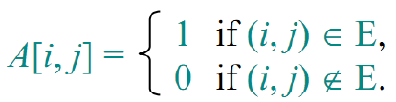
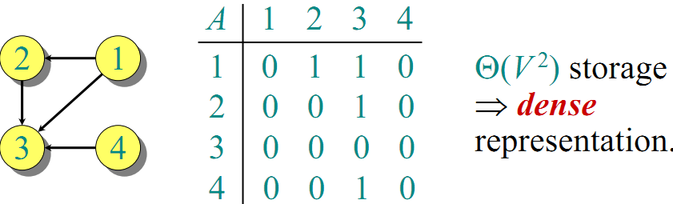
Adjacency Matrix Representation
The adjacency matrix of a graph G = (V, E), where V = {1,2,…,n}, is the matrix A[1…n,1…n] given by
The matrix is symmetric (对称的) for undirected graphs
degree(i) = number of 1s in the i-th row

Slide 11
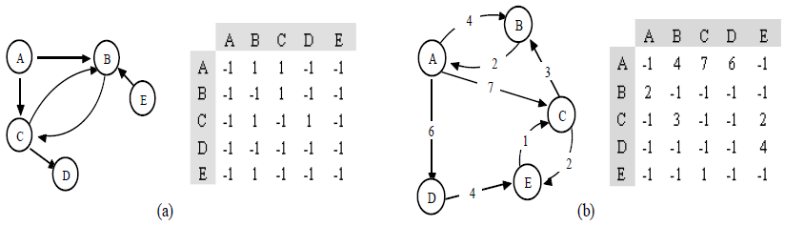
Adjacency Matrix Representation
int n; // num of vertex
int m; // num of edges
int u, v; // vertex of edge (u,v)
cin >> n >> m;
int g[n+1][n+1]; //store the graph
memset(g, 0, sizeof(g));
for (int j = 1; j <= m; j++) {
cin >> u >> v;
g[u][v] = 1;
if (directed==false) g[v][u] = 1;
}
Adjacency matrix representation for weighted graphs
-1 → +∞
-1 → 0

Slide 12
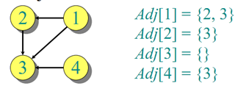
Adjacency List Representation
An adjacency list of a vertex v∈V is the list Adj[v] of vertices adjacent to v.
For undirected graphs, |Adj[v]| = degree(v)
For digraphs, |Adj[v]| = out-degree(v)

Slide 13
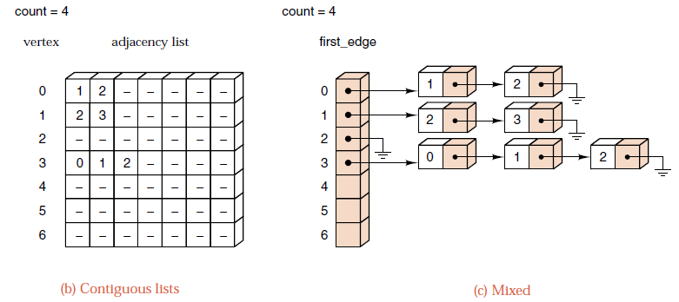
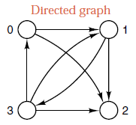
Adjacency List Representation

Slide 14
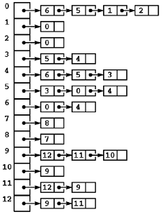
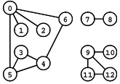
Adjacency List Representation
Use Linked list

Slide 15
Adjacency List Representation
Use STL list
int n; //num of vertex
int m; //num of edges
int u, v; // vertex of edge (u,v)
cin >> n >> m;
list<int> g[n+1]; //store the graph
for(int j=1; j<=m; j++)
{
cin >> u >> v;
g[u].push_back(v);
if (directed==false) g[v].push_back(u);
}
What if use vector?

Slide 16
Analysis of Adjacency List Representation
Handshaking Lemma: ∑_{v∈V} d(v)= 2|E|
对于n个顶点e条边的无向图，邻接表中除了n个头结点外，只有2e个表结点,空间效率为O(n+2e)。若是稀疏图(e<<n²)，则比邻接矩阵表示法O(n²)省空间。
在有向图中，邻接表中除了n个头结点外，只有e个表结点,空间效率为O(n+e)。若是稀疏图，则比邻接矩阵表示法合适。
邻接表的优点：空间效率高；容易寻找顶点的邻接点；
邻接表的缺点：判断两顶点间是否有边或弧，需搜索两结点对应的单链表，没有邻接矩阵方便。

Slide 17
Comparisons between Adjacency Lists and Matrices
Comparison | Winner
Faster for testing if (x,y) exists? | matrices
Faster for finding vertex degree? | lists
Less memory on sparse graphs? | lists O(m+n) vs. O(n²)
Less memory on dense graphs? | matrices
Easier for edge insertion/deletion? | matrices O(1) vs O(d)
Faster for traversing the graph? | lists O(m+n) vs. O(n²)
Better for most problems? | lists

Slide 18
Graph Traversal
One of the most fundamental graph problems is to traverse every edge and vertex in a graph.
  Efficiency: visit each edge at most twice.
  Correctness: do the traversal in a systematic way so that we don’t miss anything.
The key idea is that we must mark each vertex when we first visit it, and keep track of what have not yet completely explored.
There are two traversal strategies
  Depth-first
  Breadth-first

Slide 19
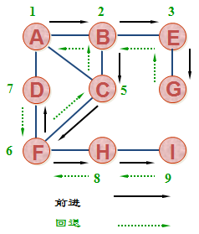

Depth-first Traversal
It is roughly analogous to preorder traversal of an ordered tree. Suppose that the traversal has just visited a vertex v, and let w₁, w₂, … , w_{k} be the vertices adjacent to v. Then we shall next visit w₁ and keep w₂, … , w_{k} waiting. After visiting w₁, we traverse all the vertices to which it is adjacent before returning to traverse w₂, … , w_{k} .

Slide 20
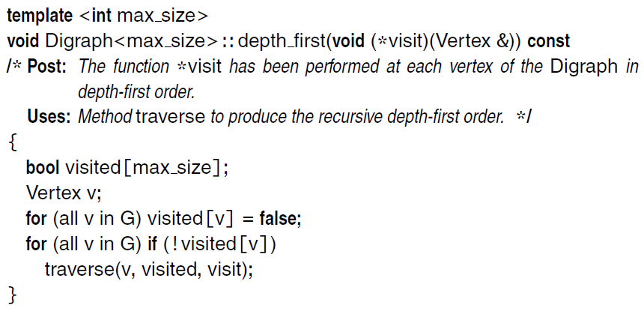
Depth-first Traversal
In case there are vertices which have not been visited, then chose one vertex and start depth first traversal until all vertices are visited.
Select the non-visited node

Slide 21
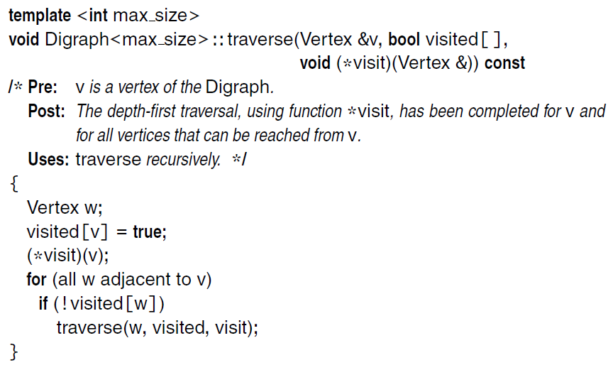
Depth-first Traversal
The recursion is performed in an auxiliary function traverse.
The vertex is marked as visited

Slide 22
Marking Vertices
任意结点总处于以下状态中的一种:
  undiscovered – 所有结点的初始状态.
  discovered – 结点第一次被访问，但它的出边未处理完毕。
  processed – 结点的所有出边都已经处理完毕。
The vertex v is undiscovered before
The vertex v is discovering
The vertex v is processed

Slide 23
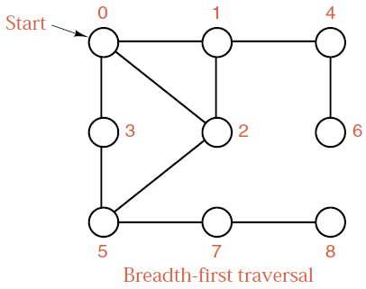
Breadth-first Traversal
It is roughly analogous to level-by-level traversal of an ordered tree. If the traversal has just visited a vertex v, then it next visits all the vertices adjacent to v, putting the vertices adjacent to these in a waiting list to be traversed after all vertices adjacent to v have been visited.

Slide 24
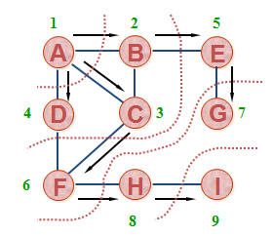
Breadth-first Traversal
Breadth first traversal can be done by using a queue. The head is the vertex to be visited. When it is visited, all its adjacent vertices are put in the queue.
Let v be the first vertex to be visited, and w₁, …, w_{k} be the adjacent vertices of v. We will first put v in the queue. Visit v and put w₁, …, w_{k} in the queue. Then visit w₁ and put the adjacent vertices of w₁ into the queue, …, until all the vertices have been visited.

Slide 25
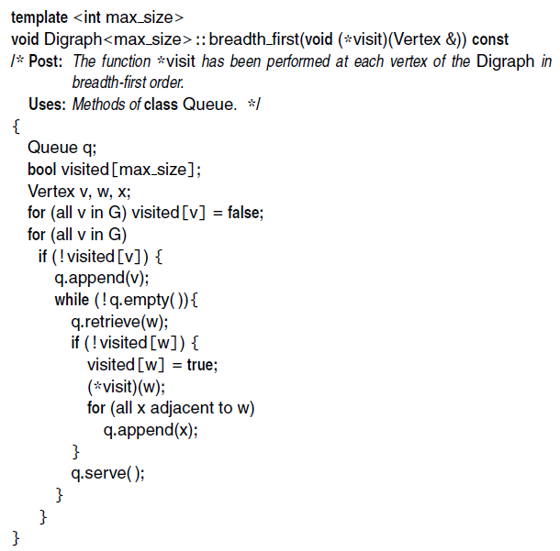
Breadth-first Traversal
The vertex w is undiscovered before
The vertex w is discovering
The vertex w is processed

Slide 26
Finding Paths
The parent array set within BFS() is very useful for finding interesting paths through a graph.
The vertex which discovered vertex i is defined as parent[i].
The parent relation defines a tree of discovery with the initial search node as the root of the tree.
vertex | A | B | C | D | E | F | G | H | I
Index | 1 | 2 | 3 | 4 | 5 | 6 | 7 | 8 | 9
parent | -1 | 1 | 1 | 1 | 2 | 3 | 5 | 6 | 8

Slide 27
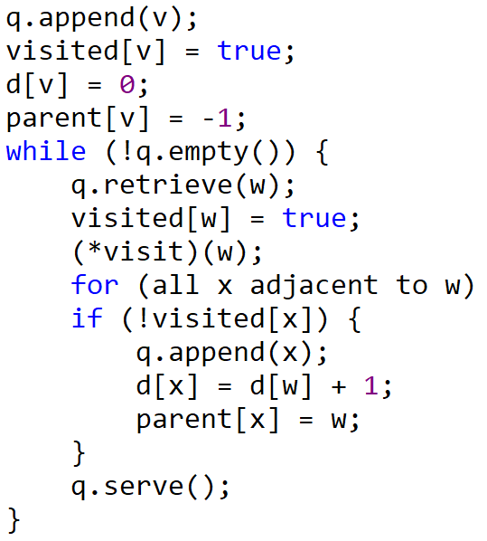
BFS Application
Shortest Paths in Unweighted Graph
In BFS, vertices are discovered in the order of increasing distance from the root, so this tree has a very important property.
The unique tree path from the root to any node x∈V uses the smallest number of edges (or equivalently, intermediate nodes) possible on any root-to-x path in the graph.
d[v]: level of v
trace parent[] to discover a path from the root to a node

Slide 28
BFS Application
Connected Components
The connected components of an undirected graph are the separate “pieces” of the graph such that there is no connection between the pieces.
Anything we discover during a BFS must be part of the same connected component. We then repeat the search from any undiscovered vertex (if one exists) to define the next component, until all vertices have been found.

Slide 29

Thank you!

